Slide 1
Intercept a Moving Ball

Slide 2


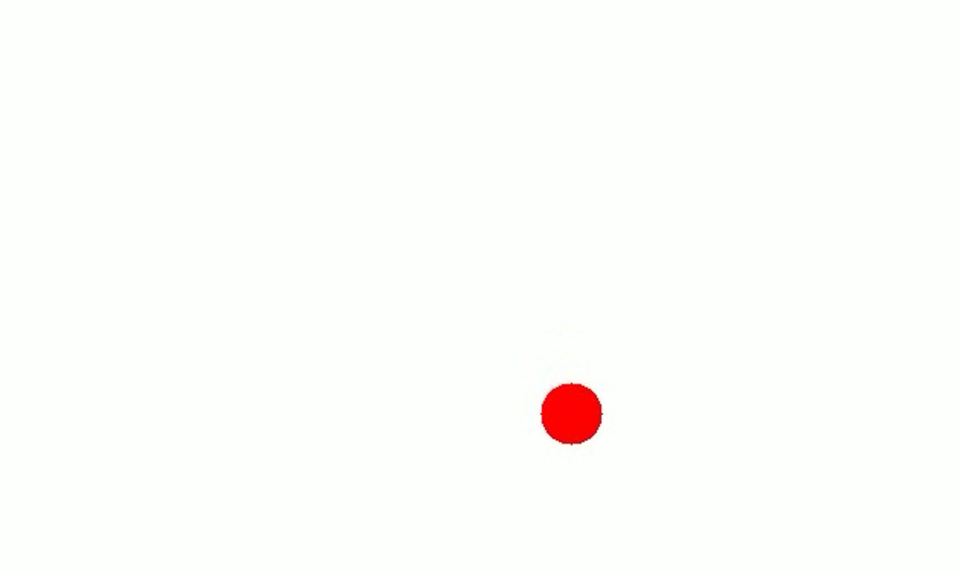
Problem Statement
We need to predict the target ball movement and intercept it with another moving ball.
Algorithm/Workflow:
I generated a moving ball animation with the help of another python code – generate.py.
Use the Computation Project 2 with some adjucements for detecting the ball, and its’ movement. which in the end returns initial position of the ball and its’ velocity.
The whole process happens in main.py, where balls initial position parameters and velocity is known, from here on, we calculate the shooting balls velocity, and angle of shooting. These are called launch parameters.
We then output those, and create a GIF.
Imports used:
numpy: for numerical computations
matplotlib.pyplot: for plotting
matplotlib.animation.FuncAnimation: to create animations of the interception.

Slide 3
Boundary Conditions
As already mentioned initial position and velocity are determined through video analysis
Launch delay ≥ 0 seconds – meaning delay can’t be negative
Just physical constraints – for it to be realistic, and reasonable speed and direction:
Launch velocity: 0 ≤ v₀ ≤ 100 m/s
Launch angle: -90° ≤ θ ≤ 90°
Numerical Methods
Shooting Method for Boundary Value Problem
The projectile interception problem can be formulated as a boundary value problem (BVP) where:
Initial boundary: Starting position of the interceptor (x₀, y₀)
Terminal boundary: Intersection with target trajectory (x_target, y_target)
Unknown parameters: Initial velocity (v₀) and launch angle (θ)
what shooting method does:
Makes initial guess for v₀ and θ
Solves IVP with these parameters
Checks if terminal condition is met
Adjusts parameters based on error
Iterates until convergence

Slide 4
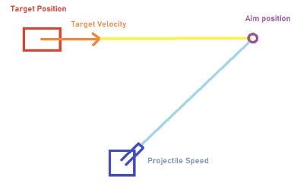
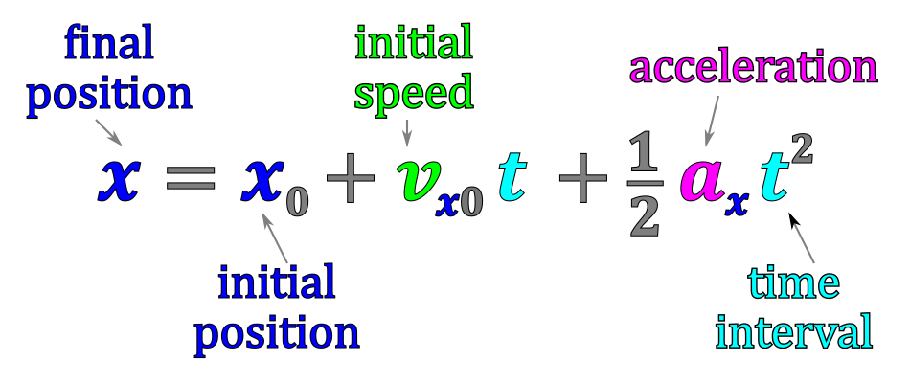
How It Works
I determine the optimal launch parameters (velocity and angle) for the shooter to intercept a moving target ball in a 2D space, factoring in gravity, initial delay, and target motion.
Also visualizing the interception using an animated plot.
Predicts the position of the target at a given time t, based on its initial position, velocity, and gravity.
Formula:

Slide 5


describes how a ball moves in the air under the influence of gravity, using differential equations.
describes the rate of change (derivative) of the ball's position and velocity with respect to time. It essentially tells us how the ball's position and velocity evolve over time as it moves.
Provides a system of differential equations for the projectile’s motion:
y is [x, vx, y, vy], representing current positions and velocities.
Method returns a list [vx, ax, vy, ay], which represents the rate of change of each state variable, where:
vx - Horizontal velocity.
ax - Horizontal acceleration.
vy - Vertical velocity.
ay - Vertical acceleration.
In a more robust implementation, we could’ve used numerical solvers like RK45:
Could be used to integrate these equations and compute the projectile's trajectory over time.
It would handle more complex forces or scenarios where analytical solutions are not feasible.

Slide 6
This is a Core Algorithm
It finds the optimal launch velocity (v0), launch angle (angle), and interception time (t_intercept) for the shooter to hit the target.
works by exploring a defined range of velocities, angles, and interception times, simulating the motion of the projectile for each combination, and determining the parameters that minimize the distance between the projectile and the target.
How it Works:
Defines a search space of velocities, angles, and interception times - ensure a detailed search for the best solution.
The function then iterates over all of those combinations.
For each potential interception time, the function calculates where the moving target will be at that specific time using its known initial position, velocity, and the equations of motion.
Simulates projectile motion for each combination and compares the projectile's position with the predicted target position.
Calculates the Euclidean distance between the projectile's position and the predicted position of the moving target at the interception time. The smaller the distance, the closer projectile is to the target ball
Keeps track of velocity, angle and time, that minimizes this distance. Function can stop within a threshold of 0.01 meters
After every combination is tested the function returns optimal solution

Slide 7
Computes the trajectory of the shooter's projectile for a given launch velocity and angle.
Returns a NumPy array containing the projectile's [x, y] coordinates at various time steps, along with the array of time values.
How it Works:
Converts the launch angle from degrees to radians, as trigonometric functions (cos and sin) in NumPy require radians.
Calculates velocity components
Calculates the horizontal/vertical position of the projectile at each time step
Returns horizontal/vertical positions at each time step
This method visualizes the interception process and returns as a gif.
Animates both the shooter's and target's trajectories in a single plot, showing how and when they intersect.

Slide 8
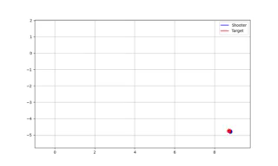
Result
The system generates two key visualizations, ball trajectory plot showing the tracked positions, and animated interception simulation (saved as 'interception.gif')

Slide 9
Limitations: The find_interception method uses a brute-force search approach, which can be computationally expensive for fine-grained parameter ranges. Assumes no air resistance or wind effects. Relies on an external module (CP2) for target detection, making it less self-contained.
Detection Results
The system successfully detects the ball's trajectory as shown in the provided plot. The trajectory shows characteristic projectile motion with:
Initial position: approximately (6.5m, 1m)
Clear parabolic path
Terminal position: approximately (8.25m, 9m)
Interception Parameters
The algorithm computes optimal launch parameters accounting for a 1-second delay:
Launch velocity optimized within 0-100 m/s range
Launch angle optimized within ±90° range
Total interception time calculated
Flight time (excluding delay) determined

Slide 10
Test Cases
1. High Velocity
Detected Initial Position: (0.98, 0.98) meters
Calculated Initial Velocity: (1.10, 3.17) meters/second
(0.98, 0.98)
(np.float64(1.0981818181818208), np.float64(3.1736363636363434))
Launch velocity: 24.14 m/s
Launch angle: -34.14 degrees
Total interception time: 1.11 s
Flight time: 0.11 s
2. Low Velocity
Detected Initial Position: (0.98, 0.98) meters
Calculated Initial Velocity: (1.10, 5.65) meters/second
(0.98, 0.98)
(np.float64(1.0981818181818208), np.float64(5.654545454545452))
Launch velocity: 4.14 m/s
Launch angle: -31.03 degrees
Total interception time: 1.85 s
Flight time: 0.85 s
3. Long Distance
Detected Initial Position: (0.98, 0.98) meters
Calculated Initial Velocity: (3.11, 0.36) meters/second
(0.98, 0.98)
(np.float64(3.1054545454545477), np.float64(0.36181818181817565))
Launch velocity: 11.21 m/s
Launch angle: -68.28 degrees
Total interception time: 4.81 s
Flight time: 3.81 s
4. Slow Target
Detected Initial Position: (6.40, 1.00) meters
Calculated Initial Velocity: (2.01, 0.74) meters/second
(6.4, 1.0)
(np.float64(2.007272727272739), np.float64(0.7372727272727113))
Launch velocity: 13.00 m/s
Launch angle: -55.86 degrees
Total interception time: 2.61 s
Flight time: 1.61 s

Slide 11
Trajectory Calculation
Brute Force Search for Optimal Interception Parameters
Search:
Iterate over all combinations of v0, θ, and t_intercept to compute the projectile's position at a given time.
For each combination, calculate the distance to the target's predicted position and track the configuration that results in the smallest distance.
Thresholding:
If the distance falls below a predefined tolerance (0.01 m), the algorithm stops early.
It is numerical because:
The solution is found by systematically evaluating discrete points in the parameter space.
It does not rely on solving equations analytically but rather approximates the best parameters.
1. Position Detection:
Pixel to meter conversion using scale factor (50 pixels/meter)
Linear regression for initial velocity estimation
Quadratic fitting for accounting gravitational effects
2. Interception Calculation:
Grid search optimization over velocity and angle ranges
Error minimization for finding optimal intersection point

Slide 12
Algorithm
1. Initialize search space for velocity and angle
2. For each time point:
Calculate target's future position
For each velocity-angle combination:
Compute interceptor trajectory
Calculate minimum distance to target
Update best parameters if better solution found
3. Return optimal launch parameters

